Slide 1
Artemmis Framework for Automotive Platforms - Overview – Business Unit ID HMI Software Group BBU
B. Bach, ID RD SW GA M
Revision: 1.1

Slide 2
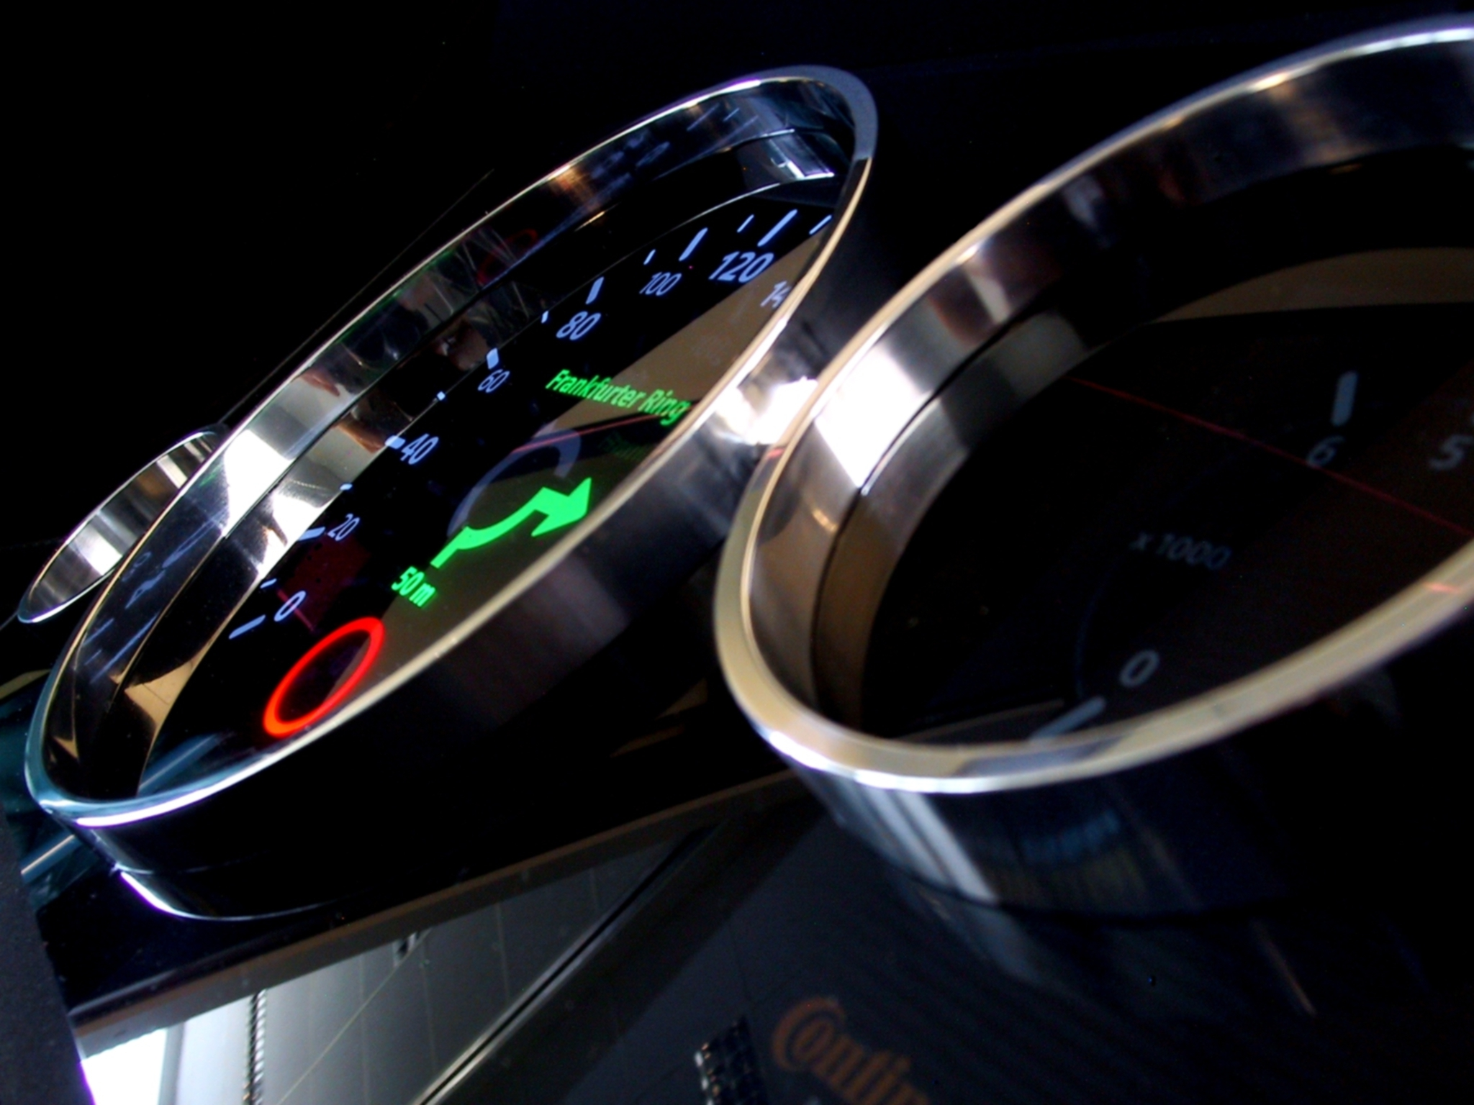
Artemmis Framework & Tool Chain for Automotive Platforms
Introduction

Slide 3
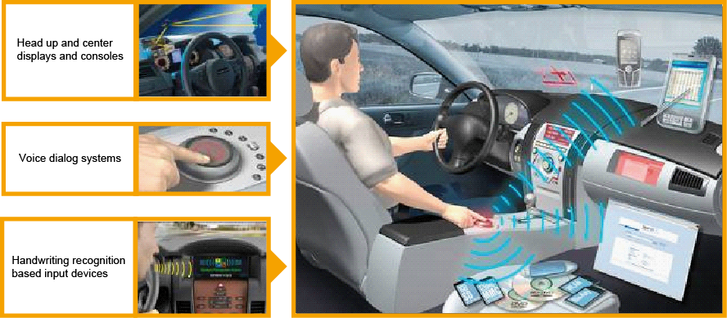
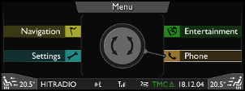
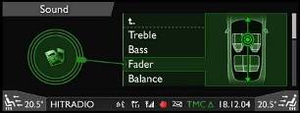

Artemmis Framework for Automotive Platforms HMI Infrastructure
Handwriting
Recognition
based
Input Devices
Voice Dialogue
Systems
Notes:
Abbreviation HMI stands for Human Machine Interface. HMI is the way humans interact with electronic devices. On computers there are two main kinds of HMI:
CLI – command line interface, where user types commands, and system executes them (possibly providing results back on screen)
GUI – graphical user interface, where user uses images to see current status of the controlled program and uses usually mouse and keyboard to control that program (in tablets and smartphones we have touch screens).
There are some other kinds of user interfaces; just to mention that even now some devices has support for voice UI. Perhaps if we want to get such kind of UI we need to introduce some kind of keyword before commands, so that car will not accidentally execute some command (during conversation of driver and passenger): a good candidate for such a command is some word which is not used normally and has no meaning, for example: “abracadabra”.

Slide 4
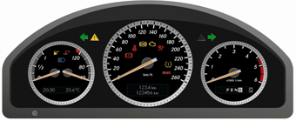
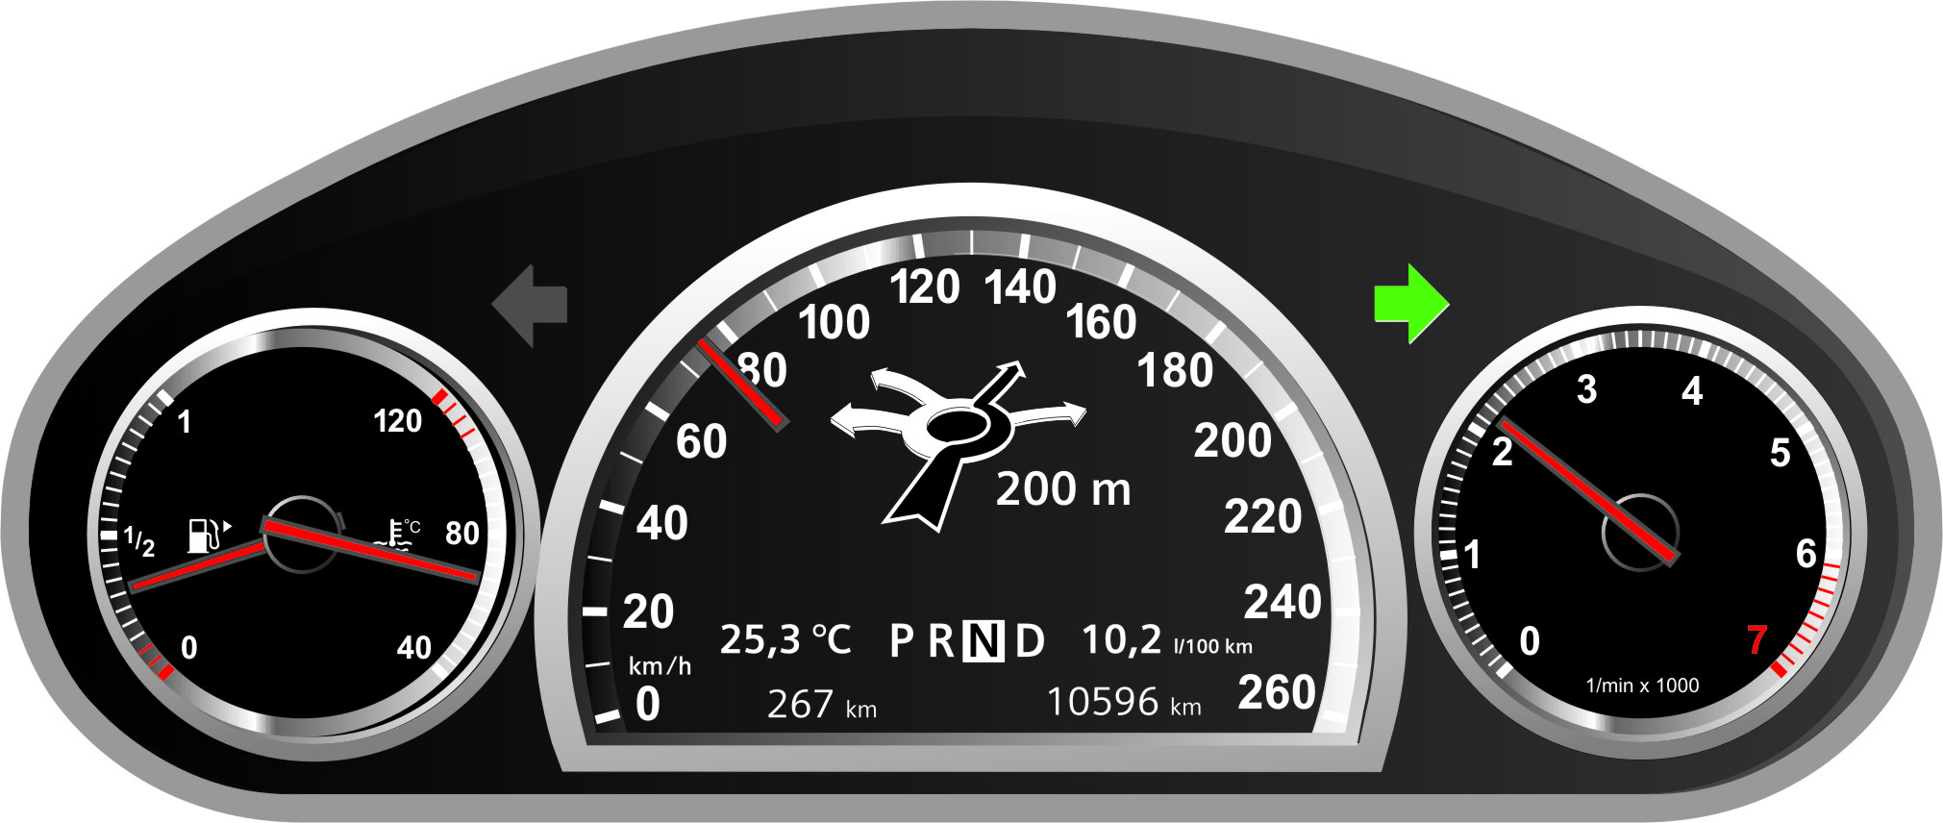
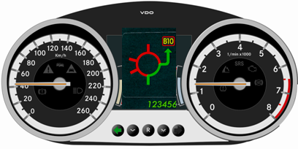
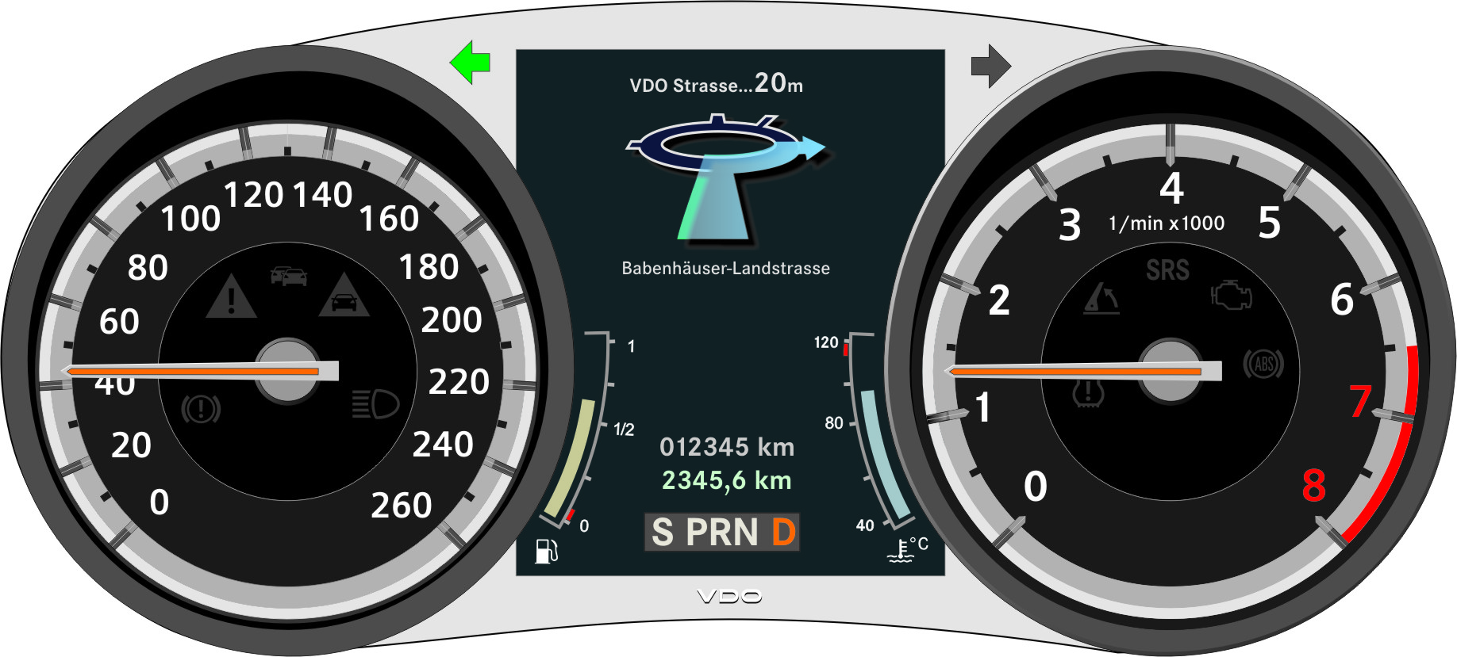
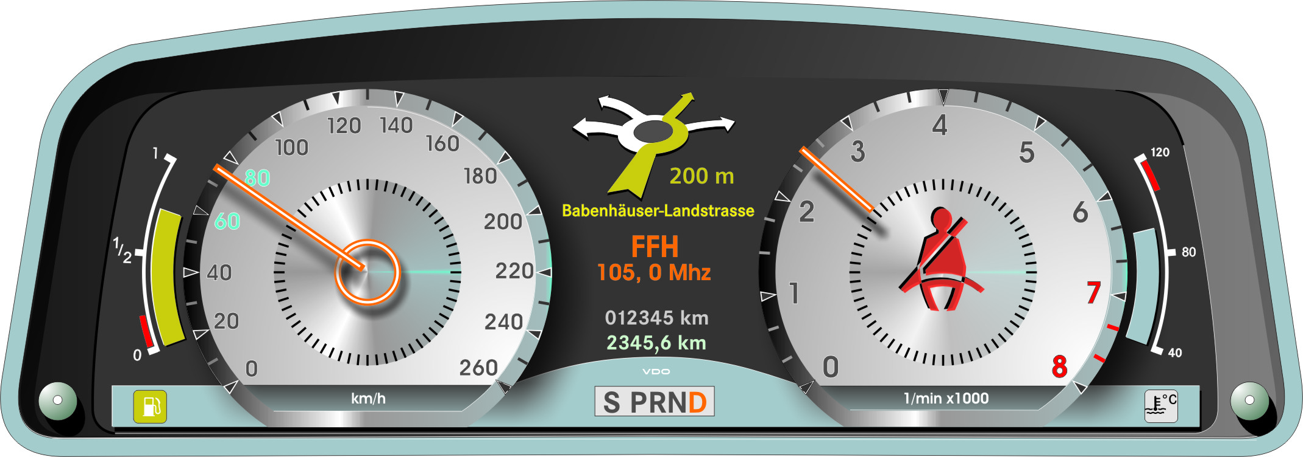
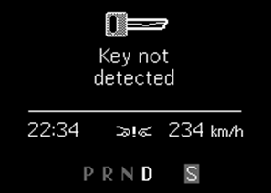
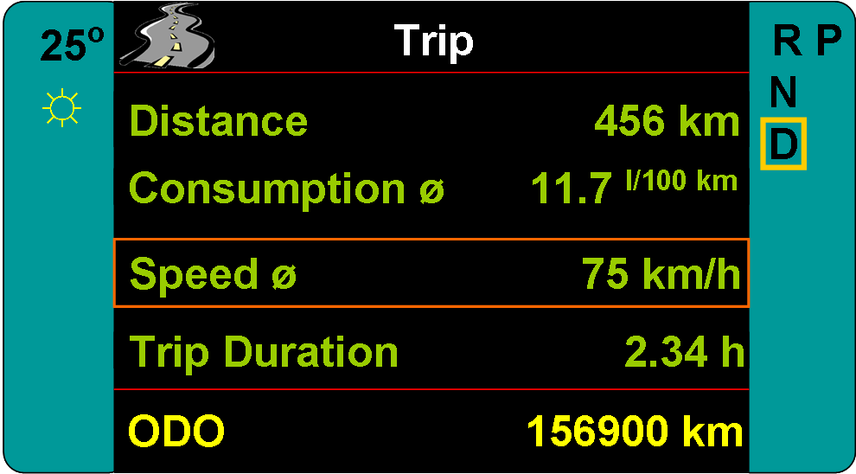
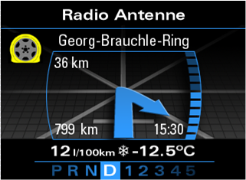
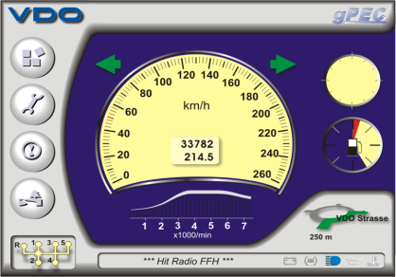
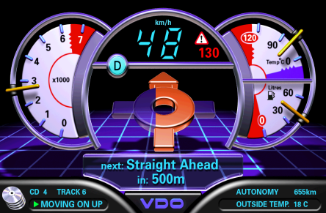
Artemmis Framework for Automotive Platforms Graphical Functions in the Conti Cluster Product Spectrum
Regular
Advanced
Premium
Black&White Dot-Matrix
Medium gray / color-TFT
Below QVGA (320*240)
Medium TFT
QVGA Class (320*240)
Large TFT
WVGA Class (800*480)
Full Size TFT
HXGA Class (1600*600)
High Quality Fonts
Color Bitmaps
Animation Effects (20Hz)
Transparency
Photo-realistic Graphics Quality (High Resolution, Anti-Aliasing)
Real-time Graphics Effects (60-120Hz)
Animated Graphical Pointer
Highly flexible Appearance
Video Overlay
2D/3D Vector Graphics
Fonts
Bitmaps
Increasing Graphical & Logical Functionality
Notes:
Artemmis HMI is a GUI type user interface. It can control either SLDC displays (with fixed number of icons on screen) or full graphic displays ranging from small one inside mechanical clusters to huge displays without any mechanical part. Artemmis can control more than one display attached to the system.

Slide 5

Artemmis Framework & Tool Chain for Automotive Platforms HMI Requirements: Reconfigurable Cluster Instruments
Clear presentation of information on large display
Increased amount of functions create a need for new ways of displaying them
Situational adaptability for optimal information management as well as adaptability regarding driver state and trait
Safe guidance of driver by optimally displaying information of comfort advanced driver assistance systems
Flexible use of different scenes (e.g. pointers move sideward to give way to night vision)
Ability to choose different profiles resulting in different display contents, styles and colors
Personalization of content and style due to individual needs
Eco
Comfort
Sport

Slide 6





Artemmis Framework & Tool Chain for Automotive Platforms Basic Concept
OEM Domain
Conti Domain
Modeling
Tool 1
HMI Modeling Language 1
Model Cross Compiler 1
Conti
HMI Language Compiler
C++ Compiler
Visual Modeling
Modeling
Tool 2
HMI Modeling Language 2
Artemmis
Runtime
System
Multiple 3rd Party
Modeling Tool Adaptability
Model Cross Compiler 2
Conti Embedded
HMI Language
Modeling of
User Interactions
Artemmis
HMI Toolchain
Modeling of System
Interactions
Viewer / Editor
Modeling
Tool n
HMI Modeling Language n
Cluster Instrument
Model Cross Compiler n
System Scalability and Reuse
across Cluster Product Spectrum
Modeling of
Visual Behavior
Model Transformation
Code Generation
OEM-driven,
Off-the-shelf
Standard HMI
Tool Solutions

Slide 7
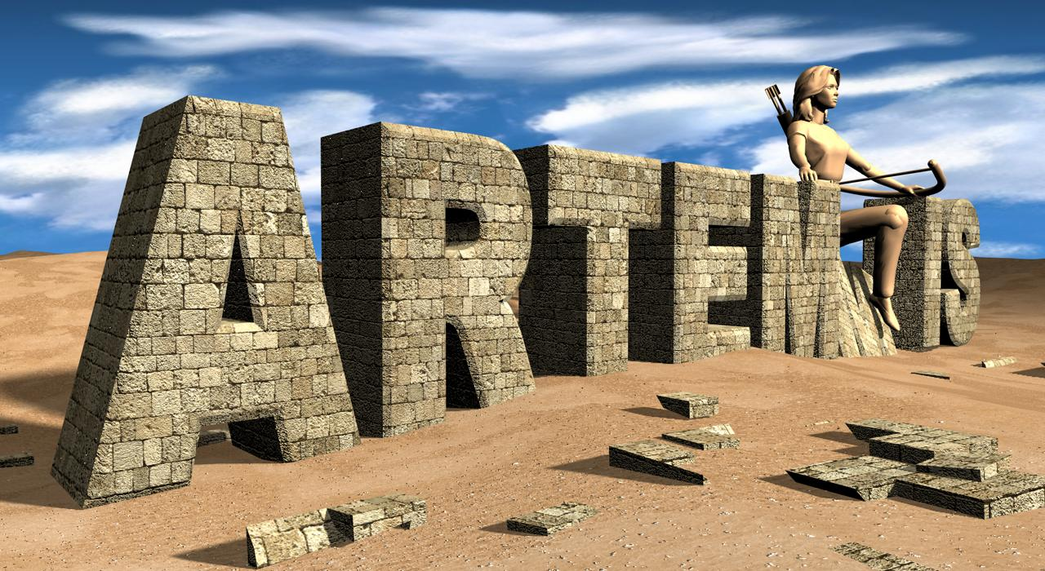
Artemmis Framework & Tool Chain for Automotive Platforms What is Artemmis?
Artemmis is the Development Name for the next Generation HMI Tool-Chain and HMI Framework Software Development at Conti Division ID
Artemmis meets the needs to design, generate and productize Next Generation Human Machine Interfaces for embedded Cluster Instruments across the Conti Cluster Product Spectrum
Automated and Reconfigurable Toolchain for Embedded Man Machine Interface Systems

Slide 8
Artemmis Framework & Tool Chain for Automotive Platforms
Artemmis Technical Core Concepts

Slide 9
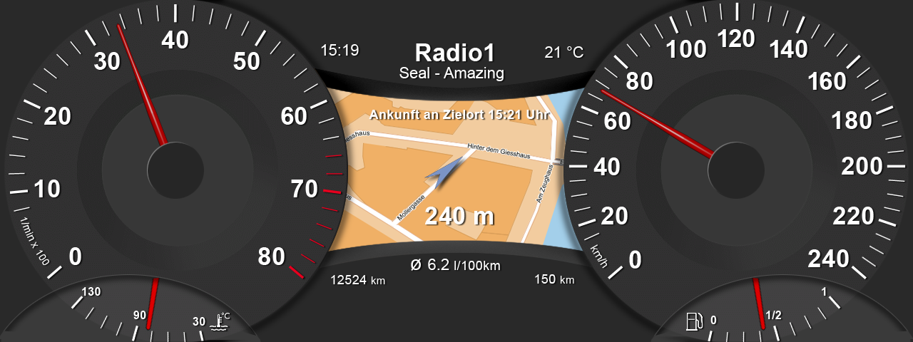
Artemmis Framework & Tool Chain for Automotive Platforms Visual Representation
Dial
Pointer
Clock
Infotainment
Ambient Temperature
ODO
Navigation
Trip
Notes:
Important characteristics of clusters are that they have usually only keyboard (located on steering-wheel) and does not provide any pointing device (no mouse, touchpad, touch screen), but this doesn’t close the possibility to have such in a future.
A common characteristic of all GUI interfaces is Event Driven approach. After start user interface displays current state of machine and awaits events from user.
Possible events are:
- keyboard input from user
- incoming data from any of the sensors
Events are always handled sequentially. After processing every single event user interface may change it internal state and display new status to the user. If there are more events pending then user interface may first process more than one (sometimes all of them) and then display final state to the user.

Slide 10

Artemmis Framework & Tool Chain for Automotive Platforms System Analysis: HMI Data Transformation Process (1)
The
Vehicle
System
The Cluster
The Cluster System
Driver Commands
Artemmis
HMI Subsystem
GS2
Commands
Graphic Subsystem
GS2/3
HW
Commands
The IO Bus
Cluster
State
Display
V-Sync
The Display
HMI Data Transformation Process
e.g. 1Byte/s
e.g. 1GByte/s
HW Data Throughput (Scene dependent)
The HMI Data Transformation Process describes the Interpretation and Transformation of Display relevant Cluster IO Data into Pixel Data on the Cluster Display
The HMI Subsystem is responsible to transform Cluster States and Driver‘s key input into a sequence of GS2 (e.g. Graphical) Commands
The Graphic Subsystem is responsible to transform GS2 commands into Pixel Data using Hardware commands
Interesting Aspect: The Hardware Data Throughput from Cluster IO Bus to the Display Bus may expand (scene dependent) by factor up to 1e+9
Notes:
It is interesting to notice that there is a huge increase of data processed from HMI input (which comes with about 1 byte/sec as events or values from sensors) to sometimes (for big displays) 1 GByte/sec.

Slide 11
Artemmis Framework & Tool Chain for Automotive Platforms Design Pattern "Model View Controller"
Model
updates
manipulates
View selection
View
Controller
sees
uses
USER
Model
Encapsulates application state and data
Includes also calculations and algorithms
View
Renders the model
Controller
Defines application behavior
Maps user actions to model updates
Notes:
Artemmis is built with Model-View-Controller (MVC) architecture.
Model consists of application data and business rules. Controller mediates input, converting it to commands for the model or view.
A view can be any output representation of data, such as a chart, diagram or table. Multiple views of the same data are possible, such as a pie chart with table below it, representing same data.
A controller can send commands to Artemmis to change the view's presentation of the model (switching different modes). It can send commands to the model to update the model's state.
A model notifies its associated views and controllers when there has been a change in its state. This notification allows the views to produce updated output, and the controllers to change the available set of commands.
A view requests from the model the information that it needs to generate an output representation.
In Artemmis model is the automotive application which receives data from the machines and processes it accordingly. DPOOL is just a way to share data with HMI.
Views are all those elements called “widgets” in Artemmis which render the model. Controllers are all applications running in cluster.

Slide 12
Artemmis Framework & Tool Chain for Automotive Platforms Widget Concept
Widget
Model
Properties
View
Controller
Definition:
A widget (window gadget) is an element of a Graphical User Interface (GUI) that displays an information arrangement changeable by the user
Characteristics:
has a set of properties that can be linked to a model
has a view part that draws the widgets
has a controller part that defines the behavior of the widget
reacts on user interaction
follows an object oriented approach
can be arranged hierarchical
Notes:
Word widget comes from computer GUI. It is a combination of window and gadget. It is used in XWindow world. In MS Windows widgets are known as controls. Artemmis HMI borrows name widget, although it is not exactly window and gadget. In Artemmis window part is separated from widget, but widgets has a pointer (actually it is ID) to its associated window.

Slide 13
Artemmis Framework & Tool Chain for Automotive Platforms Widget Tree
Memory Representation: Widget Object Tree
Visual Representation
Scene
#1
Frame
Display Scene Level
Settings
TextArea
Display Section Level
Section
A
Section
B
Frame
Clock
ListBox
Date
Parent Widget Level
Sttings
ListBox
ScrollBar
Language
Country
Buttons
Child Widget Level
Display
Clock
Date
Lang
Country
Back
Cursor
Geometrical Representation: Containment Relationship
ScrollBar
Notes:
Widgets are organized in hierarchical structure forming a tree of widgets.
Visually widgets occupy rectangular area on screen, with all children inside this rectangular area.
Widgets are not just static images they are dynamic objects living their own life in a tree. They display different things depending on data and communication with other widgets or external world.
To implement dynamic nature of widgets they need some kind of internal state and data to keep and display.
Widgets attributes (fundamental data valid for all widgets) like:
- Visible
- Enabled
- Focused (important attribute, the one who has the focus gets focused events, example a parent widget with two textbox children)
Widget properties are other important data, which is different for different widgets. For example widget which will display vehicle speed will keep property “speed”, while widget which displays temperature will have a property “temp”. Some widgets may need a property which depends on the properties of other widgets. For example lets assume that we have widgets with properties “speed” and “trip time” and we want to have another widget which will display distance from start. So we can define that property “distance” of our widget is “speed” * “trip time” using properties from other two widgets. What we need is that our “distance” widget is notified every time when some of this widget changes its value. Artemmis provides such thing and we call it property link.

Slide 14
HMI Framework – EPF
HMI framework provides an interface for interaction with the applications
Messages
DPool (via API manager)
Several functions to ask for HMI status (like whether queue is full, to delete some message …)
The Embedded Presentation Foundation ( EPF ) is the framework which builds and controls the widget tree
It consists out of several packages which form – together with the WFC – the HMI Subsystem
The HMI Subsystem is portable, all dependencies to the OS and system architecture are encapsulated by abstraction layers
HMI is single threaded and has its own thread
HMI is activated either when there is external message waiting for processing in external queue or if there is a change in DPool (triggered by API manager)
When HMI thread is activated it has two phases (actually it is activated twice):
EPF loop, which handles messages and data changes, this may lead to rebuild of some part of the tree
Painting, where all widget painters are called, visual representation of widgets is rendered and shown on screen
ARTEMMIS
WAS
WFC
WCS
ACE
WSMS
CIA
Image Assembly & Animation
Embedded Presentation Framework EPF
WMMS
WRS
WDS
WES
Common services
OSEK
HMI
Handling a change in external world
Task activation
EPF loop
handle data
changes
handle
messages
Finish EPF loop
Request Painting
Visualize changed tree (paint)
Task activation
Painting

Slide 15
Artemmis Framework & Tool Chain for Automotive Platforms Widget Tree Communication: Messages
Broadcast: send to all widgets
Broadcast Message
Stack: send up the focus path after consumption
Stack
Message
Focused: send to widgets on focus path
Focused
Message
Direct: send to list of configured widgets
Addressable: send to one widget (by ID)
Direct Message
Addressable Message
Notes:
There is not only data involved in visualization. Events are sent to the widget as messages:
External communication, this is always from external world (applications) to widget. Applications send message (keypress for example) and some widget will react on it. Usually application does not know in advance which widget will handle this message (moreover this depends on focus and is unpredictable). Messages could be:
focused: received by focused widget only
broadcast: received by all widgets
direct: received by predefined set of widgets
Internal communication (between widgets): often there is a need to trigger something from one widget and ask other widgets (sometimes even unknown widgets) to do something. A simple example could be a scrollbar. When scrollbar is moved (up or down) it shall sand a message saying: “Hey, my position has changed, please whoever is interested in this – react”. Then parent widget will react by changing start position of a list.
focused: received by focused widget only
broadcast: received by all widgets
direct: received by predefined set of widgets
addressable: send to concrete widget, not used in external messages, because external application should not have knowledge about details of user interface.

Slide 16
Data binding (DPool and API manager)
HMI registers in API manager for receiving DPool data
Data to be captured is determined by a list of used API's
This list is passed from the EPF to the API Manager during tree creation or change
API manager registers itself for DPool changes.
When there is a change API manager informs HMI that there is a change in DPool
When HMI is activated it:
locks API manager. During lock API manager copies all changed data to its freeze buffer
Activates all widgets so that they will handle data changes
Continues with message handling (if any)
Unlocks API manager (this effectively copies back data to DPool)
Paints
Widget Tree
Copy on lock
DPOOL
API_MANAGER
data1
Freeze Buffer
data2
data1
data3
data3
dataN
Copy back on unlock
Notes:
Data from external DPool is important for HMI. Many of widget properties are calculated based on that data. Because of the way it is used we call this usage API calls. We want to make sure that all widget will see same data from DPool during processing of a external message, otherwise we will have inconsistent data for different widget. There is a special component API manager for this.

Slide 17
Artemmis Framework & Tool Chain for Automotive Platforms Properties: property links
Widget property can depend on another widget property
When widget property is changed it notifies all widgets which depend on its property
Property link is a reference (abstract) between properties of two widgets. It is specified as a configuration and a code for notification is auto generated by the tools
Based on property links dependent widgets are notified to recalculate value of their properties
10:25
5
Average:
Timer activation
Speed: 76.4 km/h
StartTrip
Direct Message
DPool changes
w1
Frame
w3
trip: 00:45
57.3 km
API
(DPOOL)
w4
w5
Start time
Start dist
time
gear
Speed Avg
Trip time
Trip Dist
time
dist
oil
gear
speed

Slide 18
Artemmis Framework & Tool Chain for Automotive Platforms Widget Tree Control: Scene Management
Controllers are widgets which control which child (with its entire subtree) is show at any moment
Logic which scene (sub-tree) is shown is implemented as a finite-state-machine (or simply state machine)
For every state of a state machine there is usually associated sub-tree to display
Depending of the type of Controllers:
Visibility controllers show current scene and hide all others
Lifetime controllers keep alive only current scene, all other sub-trees are destructed
Transition controllers act like Lifetime but keep previous scene for a while, so new one and old one coexist for a short time
State machine may change state in response to some message or may decide to change scene based on some data (properties or data from DPool)
Manager is
implemented as
a state-machine
Root is implemented as
SceneController widget
Root
Manager
Display Scene 1
Display Scene n
Widget Tree Control to switch between multiple Scenes
Notes:
Not all the data is displayed at once on the screen, there are usually different modes which display different data or in a different way on the screen. To manage this we have to hide some of the widgets and show other widgets. This is done by showing and hiding entire subtree of widgets. Often we have not enough space for all widgets in a cluster (some project has several hundreds of widgets in total), in such cases we not just hide widget, we destroy entire subtree of widgets and then rebuild new one (for the new mode).
Which subtree to be shown and how to react on some messages is decided by a state machines. State machines are implementation of finite-state machine (FSM) or finite-state automaton, or simply a state machine. State machines have several states and transition between states. FSM react on received messages by changing (or not changing) their state. When they change state they trigger some action (usually calling some method or methods) and during that action subtrees of widgets are rebuild and entire widget tree changes.

Slide 19
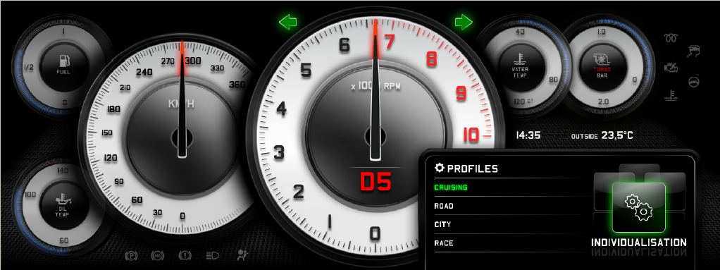
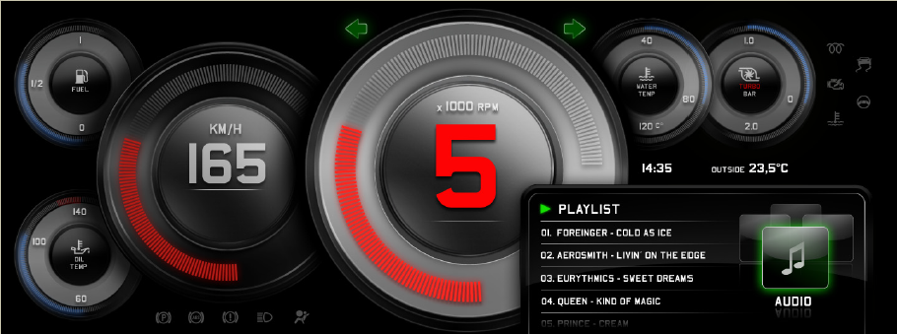
Artemmis Framework & Tool Chain for Automotive Platforms Dependencies (localization)
Localization in Artemmis is called “Dependency”, because widget visualization depends on “profile”, for example language, country, mode, etc.
Dependency is supported by ARTEMMIS and GS2
In ARTEMMIS, we can switch widget property values based on the dependency setting.
In GS2, we can switch the graphical resources like images, text, and font to another set based on the setting to provide different visualization.
Example: In cruising mode, white dials with numbers are used and the values are shown by pointers. In race mode, black dials are used and the values are shown in numbers and bar graphs.
Cruising mode
Race mode
Notes:
In the example above:
The widget visibility of pointer and bargraph can be switched using property dependency
The dial bitmap can be exchanged using GS2 support (or also property dependency)

Slide 20
Artemmis Framework Model based approach in Artemmis
Customer Modeling
Tool (if any)
Customer Tool
HMI Subsystem
HMI
Framework
HMI
Widget Foundation
Class Library
Customer model
Cross Compiler
VDO Embedded HMI Language
HMI Language Compiler
Brutus
HMI generated C++ code
Model Transformation
Code Generation
Notes:
Creating all widgets programmatically would be a huge amount of hardcoded widgets and is not easily maintainable. Moreover even during implementation phase it will be hard to work.
All GUI frameworks provide a way to create widget tree by defining it not programmatically, but in a configurable way. This is what we call “model”. Model in Artemmis is a configuration of widget tree plus all resources we would need for it (like images, fonts, …).
Model is described in XML text format in HMI language. This XML description (consisting of many XML files) is processed by “HMI language compiler BRUTUS”. It produces some resource data (used during tree build) and even some code for the defined by the model widget reactions to some messages. This generated code is known as “final hooks” in HMI.

Slide 21
Common Services

Slide 22
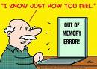
Artemmis Framework & Tool Chain for Automotive Platforms Artemmis Memory Management: Common Aspects
Artemmis uses (Half-) Dynamic Memory Management for internal objects and model-generated objects, like the widgets
Static objects (in EPF) are not possible, as the point in time, were they are constructed must be determined by the Framework and not by the compiler!
If a EC++ new() operator is called, it basically executes 2 steps: 1. call of malloc(sizeof(class)) method based on the heap allocator of the EC++ runtime library 2. call of the class constructor class()
If a EC++ delete() operator is called, it basically executes 2 steps: 1. call of the class de-constructor ~class() 1. call of the free(ptr) method based on the heap allocator of the EC++ runtime library
Both malloc() and free() methods cannot be used, as the EC++ runtime library would potentially fragment the memory heap over the time →Death of the embedded Device!
As Artemmis uses EC++ as its implementation language, the new() and the delete() operators are overwritten for all classes and directed to the Artemmis Memory Management
Notes:
Memory management in object oriented system is very important. There are many objects created and removed very often. As a result memory becomes fragmented. To address this issue we use our internal memory management. This is possible due to fact that we have BRUTUS and it can calculate all the memory we may need at once (for the widgets). The thing is that not all widgets are needed, for different modes – different sets of widgets are needed. So BRUTUS calculates which is the worst case and generates tables with maximum number of object of some size which are needed at once.

Slide 23
EXEA and Widget Error Services (WES)
EXEA is a module used by all applications to log errors, which are stored in EPROM
EXEA gets following parameters (in call to EXEA):
Module ID, number which has to be defined per module
Error ID, number which is defined
Line Number (32 bit), generated during compilation (usually with __LINE__ macro)
Optional uint (32 bit) given as a parameter
EXEA reports errors as table with 5 columns containing above 4 values plus additional count number which gives the number of occurrences if same error occurs more than once.
LineNo is not so useful as we do not know in which file. So, we will repack this information with additional FileID information
WES provides few macros to make life easier.
Macro used to log info (used term is generate exception, but this is not C++ excpetion) will combine file number with line number (i.e. (__FILEID__ << 16) + (__LINE__ & 0xffff)) assuming that there will be no more than 65000 lines per cpp file.
Finally we use simple call like: WES_ThrowError(errorId);

Slide 24
Widget Debug Services
WDS is a way to write trace info in Artemmis
On simulation trace goes into VS2005 output window (we use OutputDebugString) and/or to the log file
On target for now it does not go anywhere, but it is possible to change wrapping macros and redirect it to some useful place
In the future (this is ongoing implementation in JGP platform) it will be send to attached to the target PC
WDS defines following macros:
WDS_start(TPname, level, text, …);
WDS_stop(TPname, level, text, …);
WDS_trace(TPname, level, text, …);
WDS_start/stop are meant for using in methods. Beginning and at the end.
WDS_trace is for regular usage in any place
There are modifications of this macros with M at the end (i.e. WDS_traceM) which additionally send “this” pointer as a parameter, and they are meant for usage inside methods of a class.

Slide 25
Artemmis Framework & Tool Chain for Automotive Platforms Toolchain Dependency – more high level view
API(M) generator
APIs
Compilable system
Sizeof XML
Sizeof generator
HMI XML
API
XML
ARTEMMIS generated files (WRS)
Brutus
Cache .xml
ROMG
RSST
API .sdh
RSST-Export
RSST XML
CIA .sdh
Proseco
EVHD, DPOOL, CSHDL, …
Notes:
There are many tools, result from some of them is input for the others. For example result of API… and RSST is input for Brutus. We call all this a toolchain. All tools has to succeed in order to have successful generation of all files which after compilation and linking are finally prepared as a binary image.
Here we have full picture of all tools involved to get compilable system

Slide 26
Animation

Slide 27
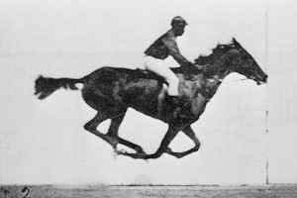
Artemmis Framework & Tool Chain for Automotive Platforms Animation: Definition
Animation (Animation is the rapid display of a sequence of images of 2-D or 3-D artwork or model positions in order to create an illusion of movement. The effect is an optical illusion of motion due to the phenomenon of persistence of vision, and can be created and demonstrated in several ways. The most common method of presenting animation is as a motion picture or video program, although there are other methods. (Source: http://en.wikipedia.org/wiki/Animation)
Within the instrumentation cluster, there are in general three common animation frequency domains required: - e.g. Animated GIF’s with ~(5Hz–10Hz) (e.g. Dropping oil can) - e.g. Animated Lists with ~(15Hz-25Hz) - e.g. Animated Pointers with ~(75Hz-150Hz)
Animated GIF‘s (converted in resource) are rendered as a sequence of static pixmaps with constant position.
Animated Lists are rendered as a sequence of static pixmaps with moving positions.
Animated pointers are rendered and assembled by a combination of static pixmaps (e.g. dial, light-map, …) and 3D mesh data (pointer) as processed by the 3D OpenGL rendering engine.
All animation frequency domains are derived from the display VSYNC signal
Source: http://de.wikipedia.org/wiki/Animation

Slide 28
Artemmis Framework & Tool Chain for Automotive Platforms Animation: Surfaces and elementary Rendering / Blt Operations
Menu
op
Copy
Rotation
Copying
Animation1
S
S
W
op
op
Paint
Rotate
Offscreen Surface
op
Copy
W
op
op
op
Paint
Scale
Alpha
Menu
Animation2
W
op
op
Scaling
Paint
Move
Hardware Layer
Animation Preparation Phase
Movement
Animation Real-time Phase
Offscreen Surface
Visible Surface

Slide 29
Artemmis Framework & Tool Chain for Automotive Platforms Interruptability - Matrix
The Matrix decides how the scheduler should handle Animations among each others based on Animation – Types.
The scheduler takes the Matrix into account if more than one Animation is requested (also more of the same type)
The Matrix consists of conflicts with dedicated behavior to consider for scheduling (described later).
In case more Animations are active the scheduler evaluates the whole line of the Matrix and uses the configurable priority of conflicts to decide what to do.
Run: The new requested animation should run and all current running animations should continue.
Wait: The new animation should wait the current animation to terminate (current running animation should continue). The new animation is added to the end of waiting list (FIFO)
Interrupt: The new animation should run and current running animation should be interrupted. The new animation will not wait for stop of running animation
Interrupt_Sync: The new animation should run and current running animation should be interrupted. The new animation will be started after the stop of running animation
Self: The new animation should wait the current animation to terminate. It is the same as WAIT except that new animation is added to the top of waiting list (LIFO)
alive
alive
 | Anim 1 | Anim 2 | Anim 3 | Anim 4
Anim 1 | RUN | RUN | SELF | RUN
Anim 2 | INTERRUPT | RUN | WAIT | RUN
Anim 3 | RUN | WAIT | RUN | WAIT
Anim 4 | RUN | RUN | SYNC | RUN
new
Behavior
Result of this scenario will be RUN and WAIT. The priority then decides which behavior wins.
29 / M. Büttner / 20.03.2010 © Continental Automotive GmbH
Notes:
Interruptability matrix is a simple mechanism for arbitrating what the system shall do in case of starting animation when another animation is running. The interruptability matrix is a table stating the next transition state of the current running animation when the new animation becomes active.
Run: The new requested animation should run and all current running animations should continue.
Wait: The new animation should wait the current animation to terminate (current running animation should continue). The new animation is added to the end of waiting list (FIFO)
Interrupt: The new animation should run and current running animation should be interrupted. The new animation will not wait for stop of running animation
Interrupt_Sync: The new animation should run and current running animation should be interrupted. The new animation will be started after the stop of running animation
CancelNewIfRunning: The current running animation should continue and the new one should be aborted
CancelAllRunning: All current (active and waiting) animations will be stopped and the new one will be started
CancelAllRunning_Sync: All current (active and running) animations will be stopped and the new one will be started. The new animation will be started after the stop of all running animations
Self: The new animation should wait the current animation to terminate. It is the same as WAIT except that new animation is added to the top of waiting list (LIFO)

Slide 30
Composite Image
Assembly

Slide 31
Artemmis Framework & Tool Chain for Automotive Platforms CIA - Everything is about windows!
Window
as a window
Window
as a window manager
Surface
31 / R. Bermejo / 13.07.2010 © Continental Automotive GmbH

Slide 32
Artemmis Framework & Tool Chain for Automotive Platforms Compositing Image Assembly (CIA) Work Model
Managing Complexity in HMI
HMI Model
Widget Tree
Model driven HMI allow the definition of complex Widget trees.
The widget tree itself and therefore the model description is however incomplete!
The way of how to compose the display contents from different parts of the model is missing.
In order to manage the complexity, it is necessary to describe the display composition independently from the HMI model.
This display composition description can be seen as scene management.
CIA allows the decomposition of the HMI application according to the scene management and graphic architecture of the Hardware.
Currently we have a 1:1 relation Widget to Window
Widget
Window(s)
Surface
Widget
Widget
Widget
Widget
Widget
Widget
Widget
Widget
Source: M. Büttner

Slide 33
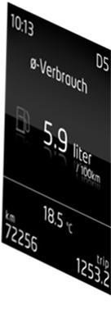
Artemmis Framework & Tool Chain for Automotive Platforms Compositing Image Assembly (CIA): Time Domains
Caution: Synchronization required !
You may not flip surface 2 while surface 1 is rendering!
VSync
Event
Window
Surface 2
Time Domain
Surface 1
P1
P2
P3
P4
P5
Time Domain
-A Time Domain is an entity, which is coupled to an event- or time-triggered (VSYNC) context
-A Time Domain aggregates a window tree, which is bound to at least one surface image buffer
A Time Domain executes a set of painters, which are responsible to draw image contents
Source: M. Büttner

Slide 34
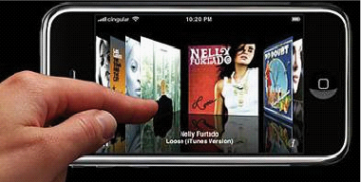
Artemmis Framework & Tool Chain for Automotive Platforms Animation: Compositing Window Management Architecture
WidgetTree
Animation
Management
(ACE)
Image
Assembly
Configuration
Animation
Scheduler
Windows / Frame buffers
Animation Control
Compositing Window Manager (CIA)
Surface
Management
Window
Management
Dependency
Detection
Redraw
Management
HW Layer
Management
Execution
Control
(Time Domains)
GS2 VM
Rendering
Serialization
R
a
f
GS2 Composition
Instruction Set
b
c
g
h
A
B
d
e
F
G
H
I
J
C
D
E
GS2
Graphic Subsystem
3D Scene Graph Management
Display

Slide 35




Artemmis Framework & Tool Chain for Automotive Platforms 3D Support: Basic Concept
Runtime System
3D Content Creation Tool
Preprocessor
3D Data
3D Data Interchange Format
Conditioned 3D Data
RS3D
RS3D toolchain
<<uses>>
3D Renderer
SGR
Notes:
Wide variety of 3D content creation tools available on the market, example: Autodesk® Maya®, Google® SketchUp®, Maxon® CINEMA 4D®
COLLADA is a COLLAborative Design Activity for establishing an interchange file format for interactive 3D applications
Defines an XML schema to describe 3D contents
Preprocessor prepares and optimizes 3D data for usage with the runtime system.
Conditioned 3D data: a set of data ready for use by the runtime system (C structure or binary data)
3D data: asset which describes the content of a 3D scene
3D Renderer: Interprets the 3D data structures and draws the geometry

Slide 36
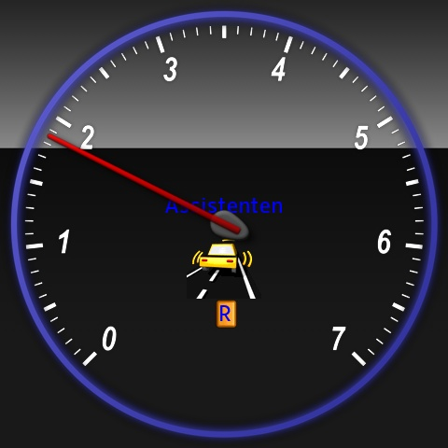
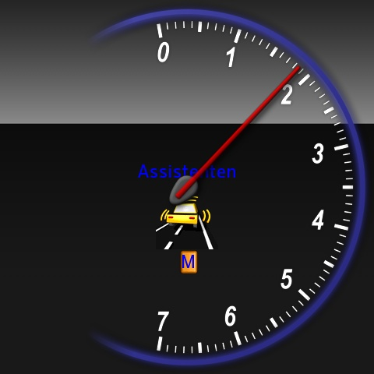
Artemmis Framework & Tool Chain for Automotive Platforms Sample gauge application with 3D (WAG package)
Figure 4‑1 Typical WAG configuration running inside simulation environment. | Figure 4‑2 Same configuration switched to another state.
Notes:
Including 3D pointer and dial animations

Slide 37
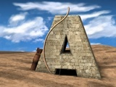
Thank you for your attention!

